Slide 1
CISCO SALES CREDITING – AI/ML PROJECT: WEEKLY STATUS REPORT
WSR: 1
Report Duration: Dec 19 – Dec 23, 2022
Project Team: Angela, Arun, Kris, Sagar, Lalitha, Nithya, Rakshit, Sathish, Puneet, Pradeep, Riddhi
Date: Dec 26, 2022
Objective: Build an AI/ML model which will accept a transaction of any transaction type as input and should predict a Salesrep & Node with a Confidence Score. The AI/ML model should learn and improve based on claims and manual allocations that occur and must reduce cases/ manual interventions
Highlights:
Remarks: Zensar team waiting for ID creation and laptops
Project Status:
Sessions conducted so far
Team introductions
High level data walk-through
What needs to be achieved by Jan 31, 2023
Set-up GCP Dev environment with CSDL review & approvals
Pull data from OTM to GCP
Set-up GCP BigQuery database
Set-up GCP Vertex AI components (JupyterLab, Kubeflow pipelines, Deployment environment etc)
Test availability of complete training data from OTM to GCP BigQuery
Run initial exploratory Data Analysis
Start model building activities (Data processing and transformations)
Show stoppers (if any):
Show stoppers:
None
Achievements (if any):
None
Action items:
Create IDs and environment access for Zensar Team
Provide support to Angela, Lalitha and team for GCP set-up: Document to be shared by Riddhi/Pradeep
Key Dependencies:
Create IDs and environment access for Zensar Team

Slide 2
CISCO SALES CREDITING – AI/ML PROJECT: Minutes of Meeting – 19. 12 . 2022
Attendees and Time: 19th December 2022, 09:00 AM – 10:15 AM PST, WebEx Online
Zensar: Riddhi Dutta, Pradeep Varanasi
CISCO: Arun, Angela, Bajaj, Lalitha + 1
Topics Covered:
Existing approach: The cases are bound with rules (combination of Node, Territory, Sales Rep ID) and a machine learning model is plugged to predict whether a case should be auto processed based on matched rules or sent to PEGA to create manually.
Existing data flow: The data is processed from OTM (Oracle Territory Management) and fed to KAFKA → Incorta → Machine Learning Model Predictions → KAFKA → Actionable Insights or PEGA
Existing challenges:
Change of Sales Rep IDs and other parameters every fiscal year
Unallocated nodes due to unassigned territories
High Auto/Manual ratio
Introduction to the data snapshot, features, primary key (transaction ID and transaction line), expected records in a quarter. (To be continued on 20th December 2022)
Zensar’s Approach/Objective:
Data cleansing recommendation, Pre-processing, Feature engineering, Exploratory data analysis
LSTM/Regression/Time-series exploration on the final dataset along with Optimization.
Reduce the Auto/Manual ratio.

Slide 3

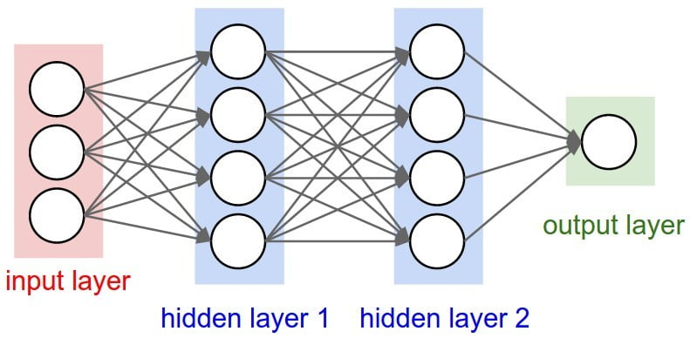


CISCO SALES CREDITING – AI/ML PROJECT: Data Pipeline Architecture (imagined)
OTM
KAFKA
GCP
ML/DL
KAFKA
Oracle Territory Management to store the sales data
Stream-processing platform that generates leads every ‘x’ minutes
Google Cloud Platform to trigger the Flask API
Data is inputted to a Machine Learning/Deep Learning model
Stream-processing platform for pushing results to the relevant source

Slide 4
CISCO SALES CREDITING – AI/ML PROJECT: Project Plan
We are here

Slide 5
Thank you!

